Slide 1
The
European
Union
“World peace cannot be safeguarded without the making of creative efforts proportionate to the dangers which threaten it.”
Robert Schuman, 1950
A unique organisation
Notes:
In this presentation, we will briefly examine what the EU is, dive into some interesting facts about the EU, and finally see how it has changed and evolved over the years.
To begin with, even though one can loosely refer to the EU as an organisation, it is a bit more complex than this.
The European Union is neither an international organisation nor an intergovernmental organisation in the strict sense.
The unique nature of the European Union is that it is not an organisation per se, but rather a set of institutions, agencies and bodies working towards the same goals and under the same flag.
Its uniqueness derives from the specific conditions under which it developed and from the objectives and ideals of its founding members.
The European project, born from the ashes of the Second World War, aimed in the first place to ensure peace by putting the means to produce weapons of war (coal and steel) under common responsibility. Over the decades, the member countries agreed to cooperate and pool resources and sovereignty to solve problems that would benefit from a common solution. This trend is still valid today if we think about issues such as climate change, international trade or our digital society.

Slide 2
The EU is a unique economic and political union
27 countries
447 million people
Notes:
In more concrete terms, the EU is a unique economic and political union between 27 countries with a total population of approximately 447 million people.
Over the course of more than 60 years, the EU has helped raise living standards, launched common projects like the euro and the single market, and worked together on big issues like climate change, COVID-19 and the digital society.
More statistics at: https://ec.europa.eu/eurostat/data/database under « Annual National Accounts »

Slide 3
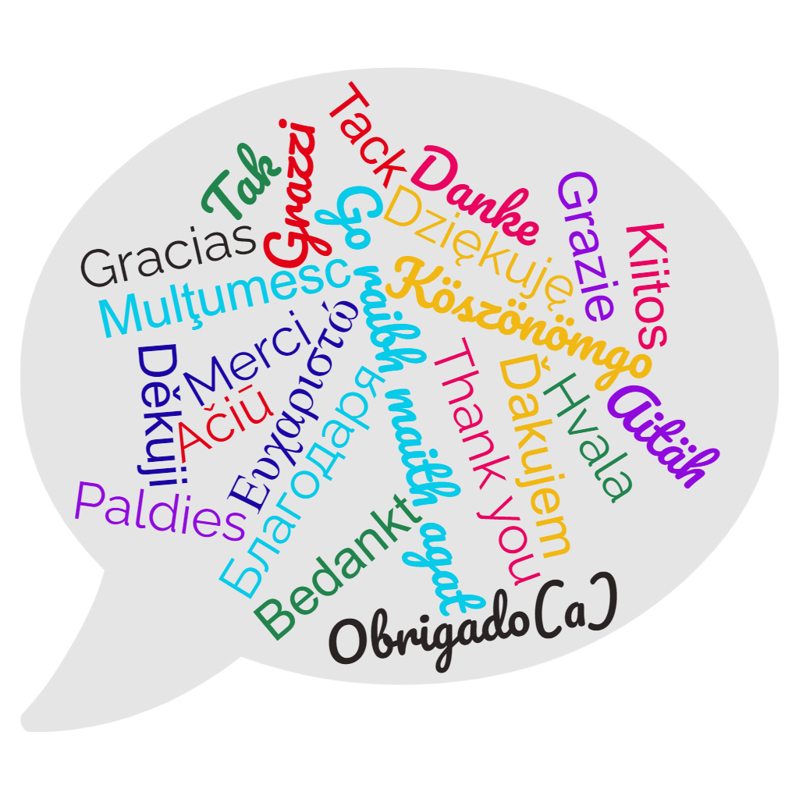
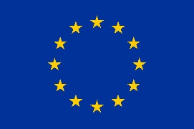
The EU’s 24 official languages
A Europe
of people
24 official languages
Listen to samples of the official EU languages
Notes:
The languages spoken in EU countries are an essential part of its cultural heritage. This is why the EU supports multilingualism in its programmes and in the work of its institutions.
Multilingualism has been a key feature of the European Union since its beginning. The EU works in 24 official languages.
The rules on the use of languages by EU institutions are laid down in Regulation No 1, which states that the institutions have 24 official and working languages.
Meetings of the European Council and the Council of the European Union are interpreted into all official languages. Members of the European Parliament have the right to use any official language when speaking in Parliament.
European citizens have the right to be informed about the Union's activities and to contact and get answers from the EU’s institutions in any official language.
In addition, Legal acts and their summaries are made available in all official EU languages.
Official EU languages:
Bulgarian, Croatian, Czech, Danish, Dutch, English, Estonian, Finnish, French, German, Greek, Hungarian, Irish, Italian, Latvian, Lithuanian, Maltese, Polish, Portuguese, Romanian, Slovak, Slovenian, Spanish, Swedish.
EU official alphabets:
Latin, Cyrillic and Greek.

Slide 4


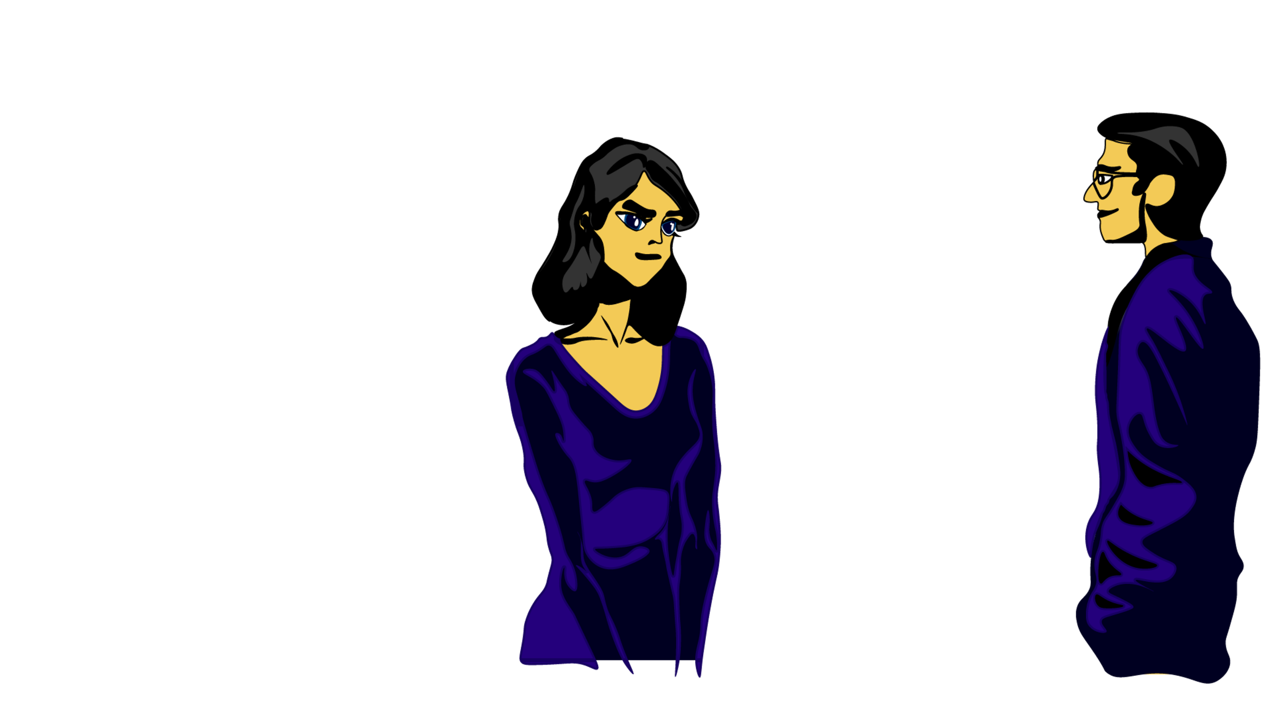
Guess the EU symbol quiz
This anniversary of an important speech is now the day when we celebrate the EU.
Created in Austria, it is now the EU’s anthem.
It makes life easier when we cross borders.
United in diversity
The EU motto
12 stars
Guess the
EU symbols
The European project is summed up in this phrase.
9th of May
Europe Day
The number of stars on the EU flag.
The Ode to Joy
The euro
Notes:
The Ode to Joy comes from the Ninth Symphony composed in 1823 by Ludwig Van Beethoven. The anthem symbolises not just the European Union but also Europe in a wider sense. The poem "Ode to Joy" expresses Schiller's idealistic vision of the human race becoming brothers. It was adopted in 1985.
The EU flag features a circle of 12 gold stars on a blue background. They stand for the ideals of unity, solidarity and harmony among the peoples of Europe. The number of stars has nothing to do with the number of member countries, though the circle is a symbol of unity. The flag was created and adopted by the Council of Europe in 1955. It became the official flag of the EU in 1985.
Europe Day is held on 9 May every year to celebrate peace and unity in Europe. The date marks the anniversary of the historic ‘Schuman Declaration’ which set out a new form of political cooperation in Europe.
The EU motto “United in diversity” signifies how Europeans have come together to work for peace and prosperity, while at the same time being enriched by the continent's many different cultures, traditions and languages.
The euro is the official currency in 20 of the 27 EU member countries. It is the proof in your pocket of European countries working together. The launch of Euro notes and coins in 2002 was one of Europe’s biggest ever logistical operations.

Slide 5
The EU’s values
• Human dignity
• Freedom
• Democracy
• Equality
• Rule of Law
• Human rights
What do they mean?
© Adobe Stock, Jacob Lund
Notes:
While the EU is characterised by diversity, its Member States share a common set of values that unite the people of Europe.
They are an integral part of the European way of life and they are:
Human dignity
Freedom
Democracy
Equality
Rule of Law
Human rights
These values are set out in the Lisbon Treaty and the EU Charter of Fundamental Rights.
Human Dignity: human dignity is inviolable, meaning it must always be respected and protected. It constitutes the real basis of fundamental rights.
Freedom: individual freedoms such as respect for private life, freedom of thought, religion, assembly, expression and information are protected by the EU Charter of Fundamental Rights. A practical example of this value is the freedom to move and reside freely within the EU.
Democracy: the functioning of the EU is founded on representative democracy. Being a European citizen also means enjoying certain rights. As an example, every adult EU citizen has the right to stand as a candidate and to vote in elections of the European Parliament. EU citizens have the right to stand as a candidate and to vote in their country of residence, or in their country of origin.
Equality: equality is about equal rights for all citizens before the law. The principle of equality between women and men underpins all European policies and it applies in all areas. The principle of equal pay for equal work (Treaty of Rome, 1957) or of non-discrimination on the grounds of nationality for EU citizens (Treaty of Lisbon, 2009) are examples of this value in practice.
Rule of Law: the EU is based on the rule of law. Everything the EU does is founded on treaties, voluntarily and democratically agreed by its EU countries. Law and justice are upheld by an independent judiciary. The EU countries gave final jurisdiction to the European Court of Justice, whose judgments have to be respected by all.
Human rights: human rights are protected by the EU Charter of Fundamental Rights. These cover the right to be free from discrimination on the basis of sex, racial or ethnic origin, religion or belief, disability, age or sexual orientation, the right to the protection of your personal data, and the right to have access to justice.

Slide 6
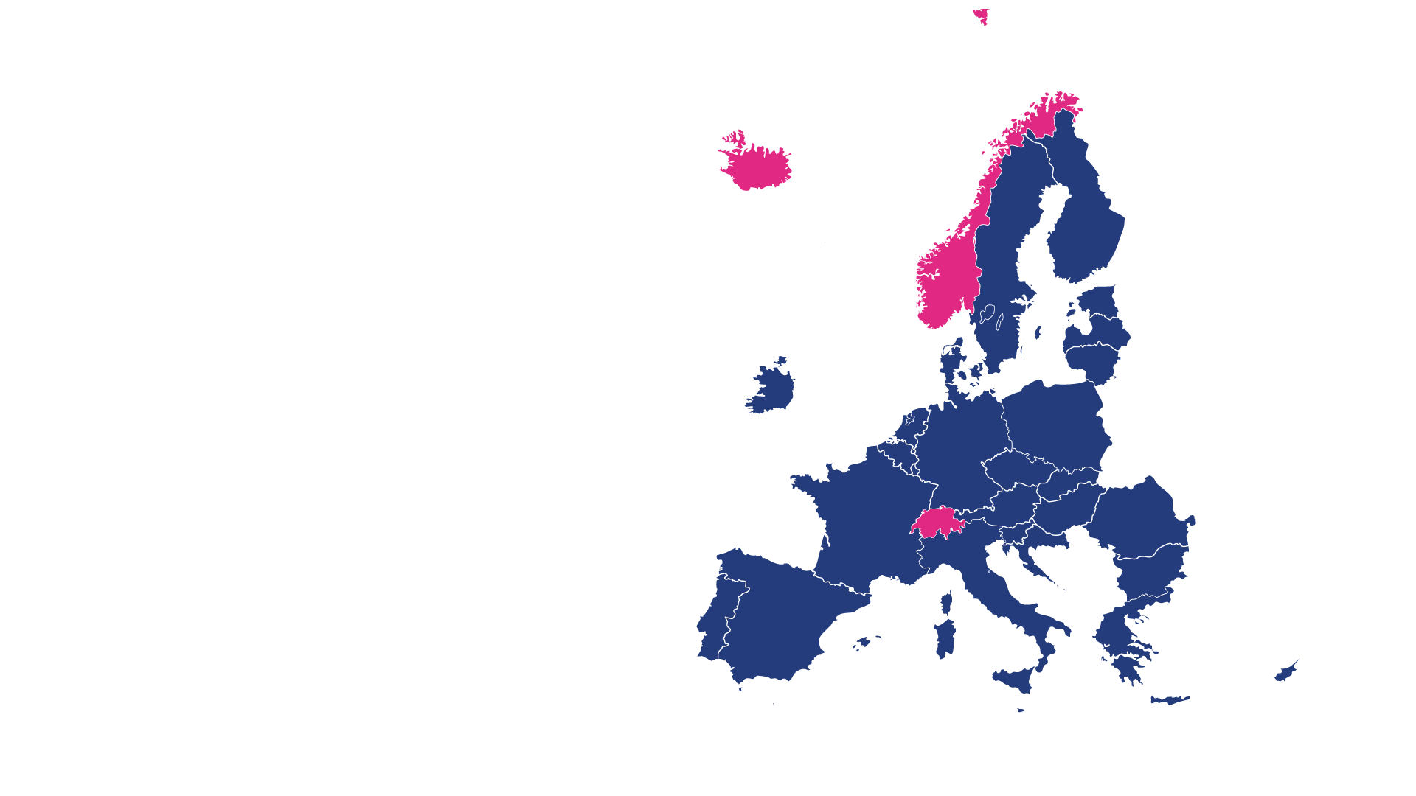
The EU consists of 27 Member States
Many countries,
few limits
The EU consists
of 27 Member states
In addition to the 27 Member States, Iceland, Liechtenstein, Norway and Switzerland are part of the European Single Market.
The Schengen area brings together 23 EU and 4 non-EU countries that have abolished passport controls at their borders.
Notes:
The EU's commitment to its shared values is reflected in the rights enjoyed by its citizens.
EU citizens can move and reside freely within the Union, and they are protected by EU laws.
They can also vote and run in European Elections.
Andorra, Monaco, San Marino and the Vatican are not part of any of these associations. Their relations with the EU and other countries are established by bilateral relations. However, Monaco, San Marino and the Vatican are de facto in the Schengen Area.
Switzerland is neither an EU nor an EEA country. It has agreed around 100 specific bilateral agreements with the EU covering, for example, many of the Single Market’s provisions. One of these agreements concerns Switzerland’s participation in the Schengen Area.
--
In addition to the 27 Member States:
Iceland, Liechtenstein, Norway and Switzerland are part of the European Single Market.
This means they have committed to the free movement of people, goods, services, and money.
EU citizens can also enjoy these rights in these four countries.
--
The Schengen area brings together 23 EU and 4 non-EU countries that have abolished passport controls at their borders.
This means that people can cross a border between two of these countries without having to show a passport.

Slide 7
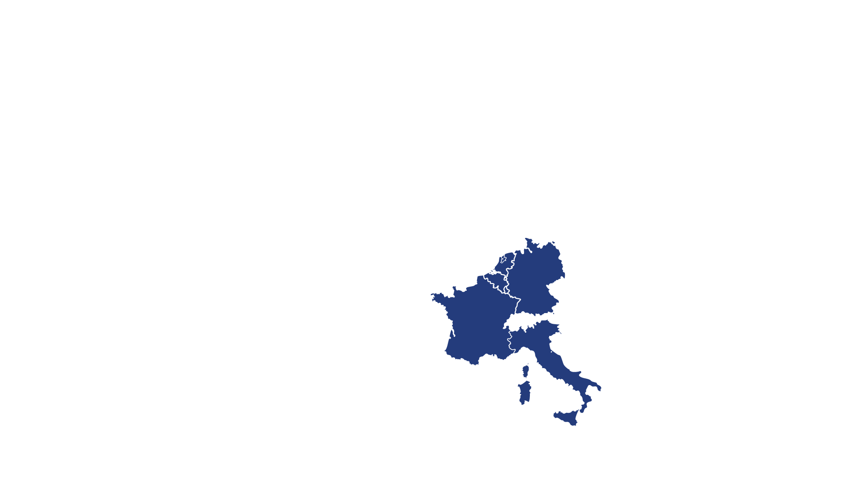
European integration in 1958: 6 countries sign the Treaty of Rome
European
integration
1958
In 1958, 6 countries founded the European Community with the Treaty of Rome. Their aim was to ensure peace and liberty and to foster economic progress.
Notes:
Next, let us take a brief look at the history of the EU by following a timeline of the countries that have joined over the years.
It all started with the 6 countries that signed the Treaty of Rome:
Belgium
Germany
France
Italy
Luxembourg
The Netherlands

Slide 8
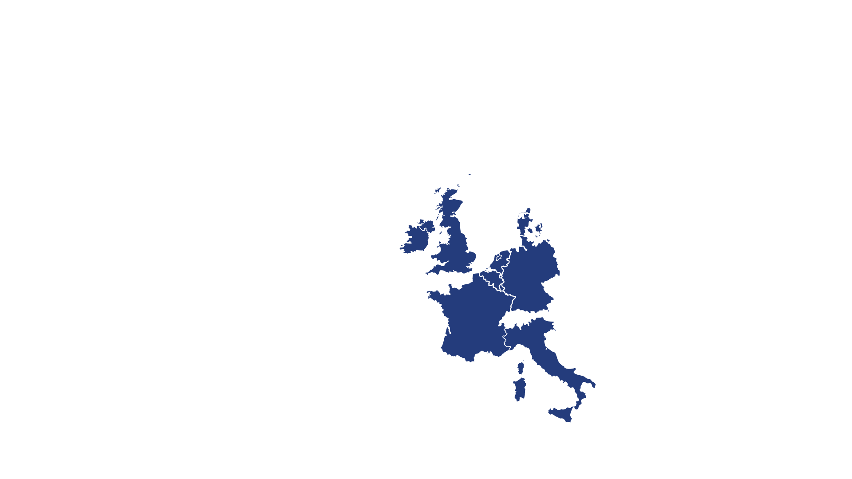
European integration in 1973: Denmark, Ireland and the United Kingdom
European
integration
1973
In 1973, Denmark, Ireland and the United Kingdom* joined the Community.
* The United Kingdom left the European Union in 2020
Notes:
[Note to the presenter: invite the audience to share their stories or memories about their country/respective countries joining the EU].

Slide 9
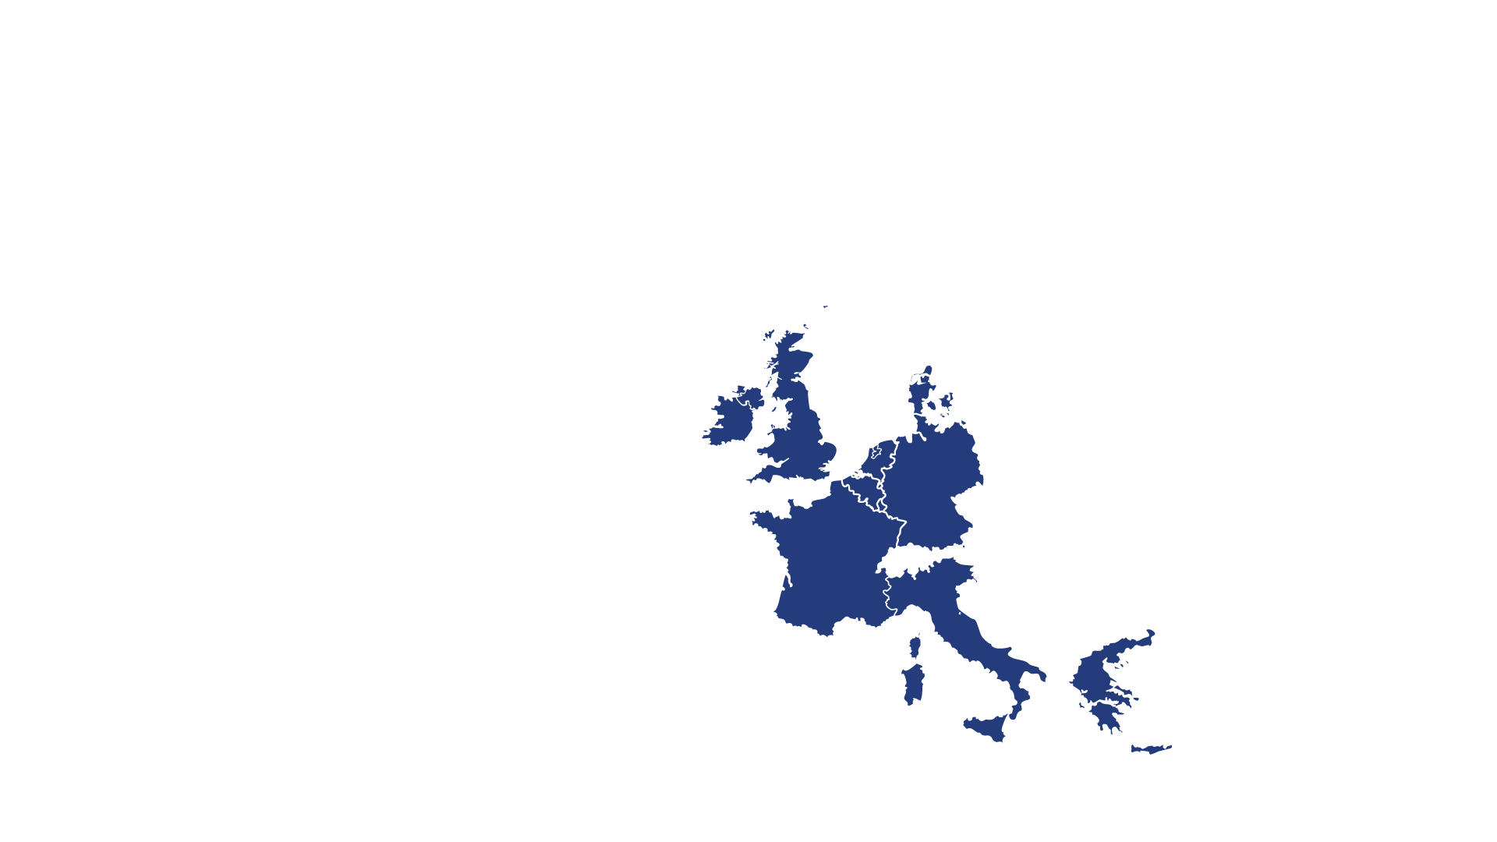
European integration in 1981: Greece joins the EU
European
integration
1981
In 1981, the accession of Greece helped to consolidate its democracy.

Slide 10
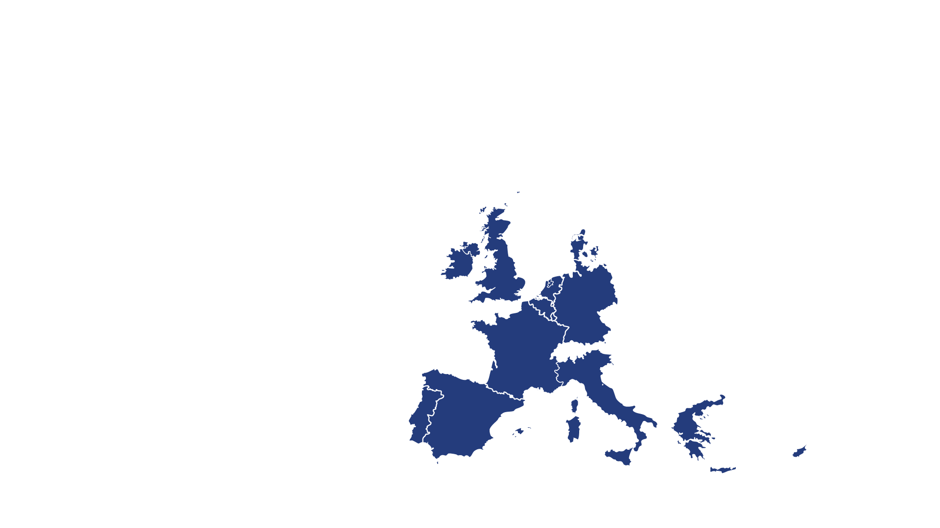
European integration in 1986: Spain and Portugal
European
integration
1986
With the accession of Spain and Portugal in 1986, the EU – still called the European Community – expanded southwards.

Slide 11
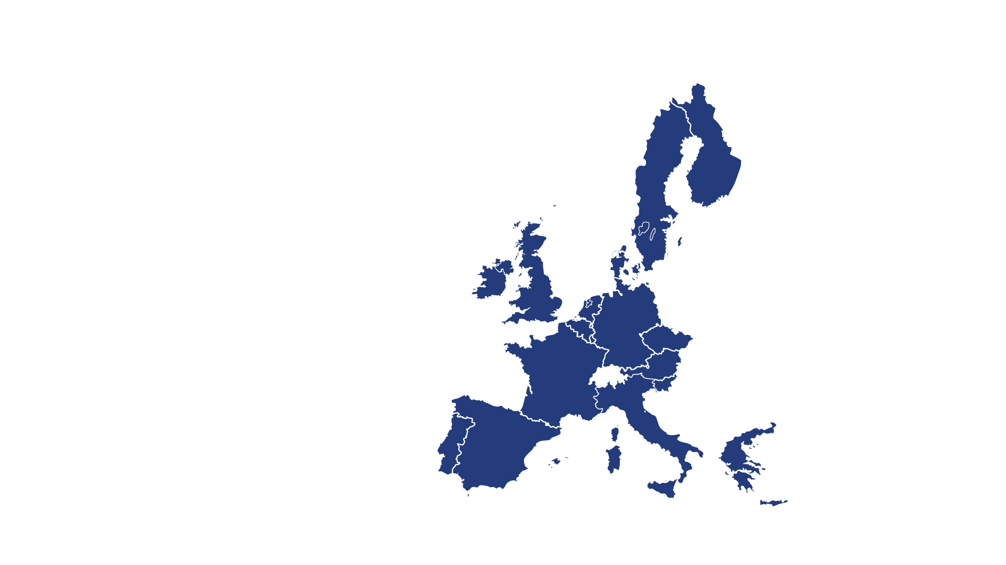
European integration in 1995: Austria, Finland and Sweden
European
integration
1995
In 1995 Austria, Finland and Sweden joined the European Union.

Slide 12
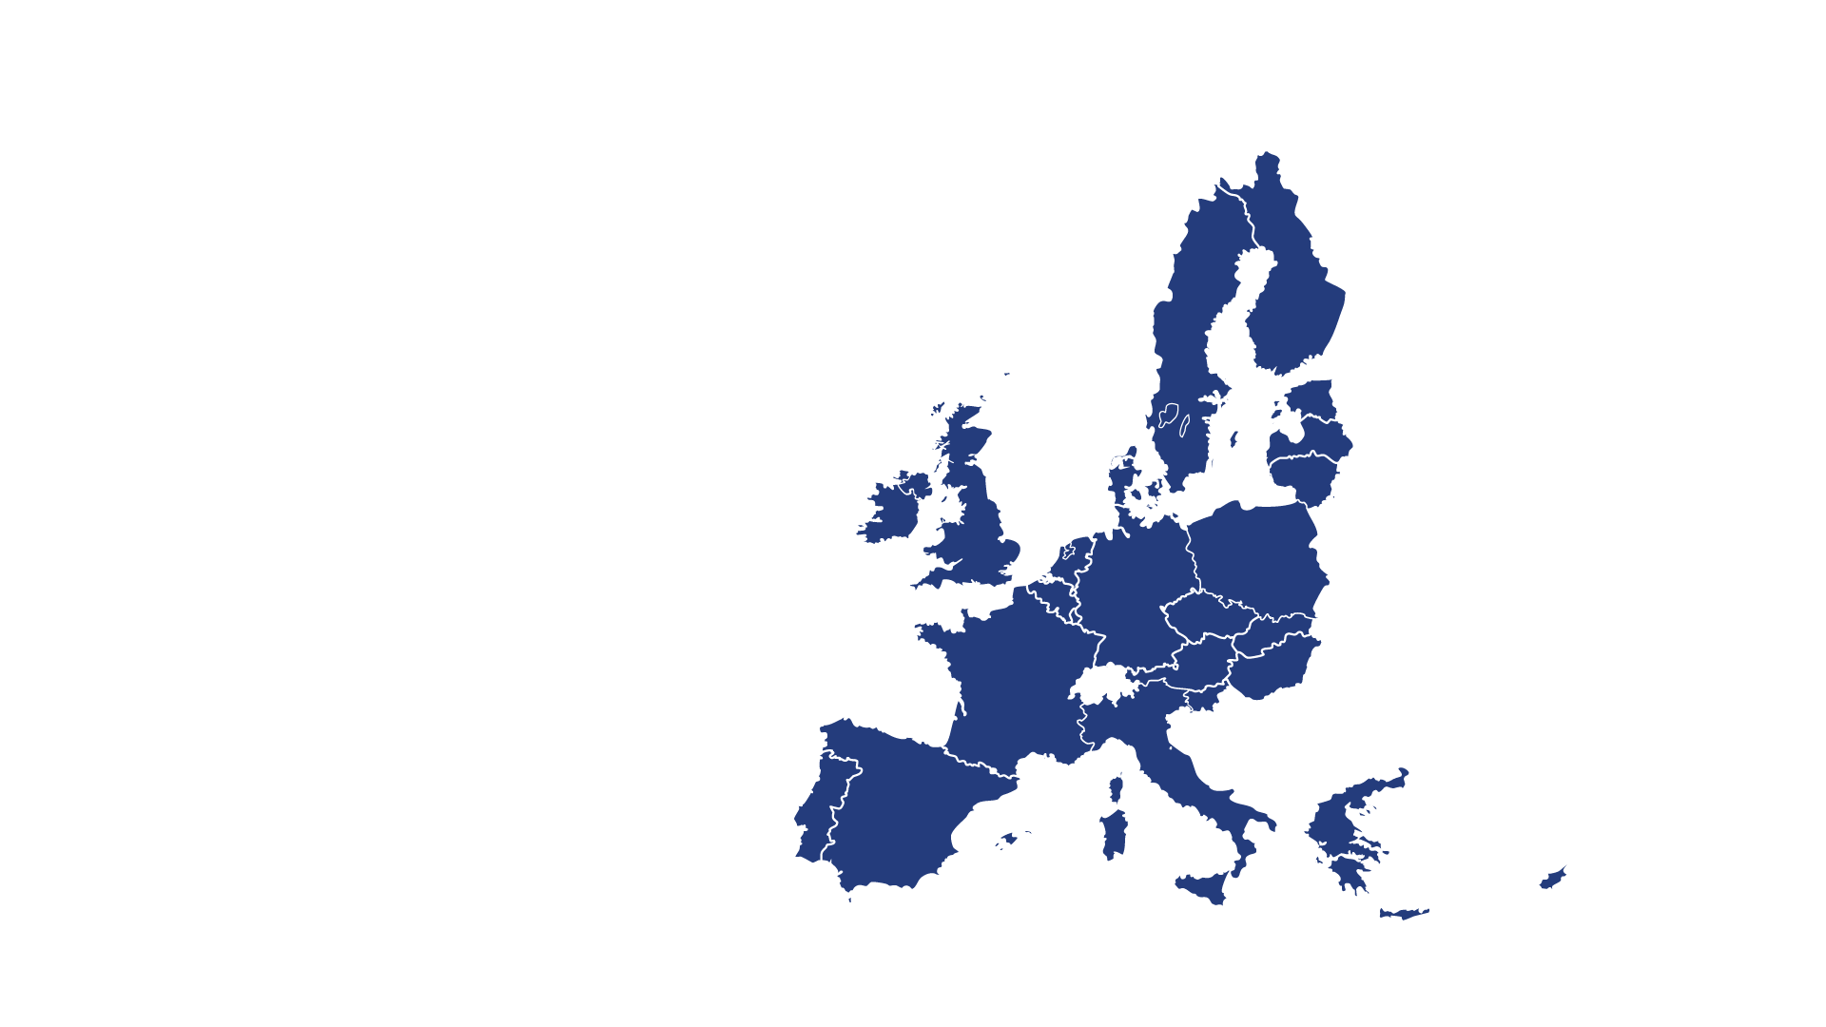
European integration in 2004: 10 countries join the EU
European
integration
2004
The 2004 enlargement reunited the continent after the fall of the Berlin Wall and the collapse of the Soviet Union.
Notes:
10 countries joined the EU on 1 May 2004:
Czech Republic
Estonia
Cyprus
Latvia
Lithuania
Hungary
Malta
Poland
Slovenia
Slovakia
Respecting the rule of law, a functioning market economy and the respect of democratic principles were among the criteria to join.

Slide 13
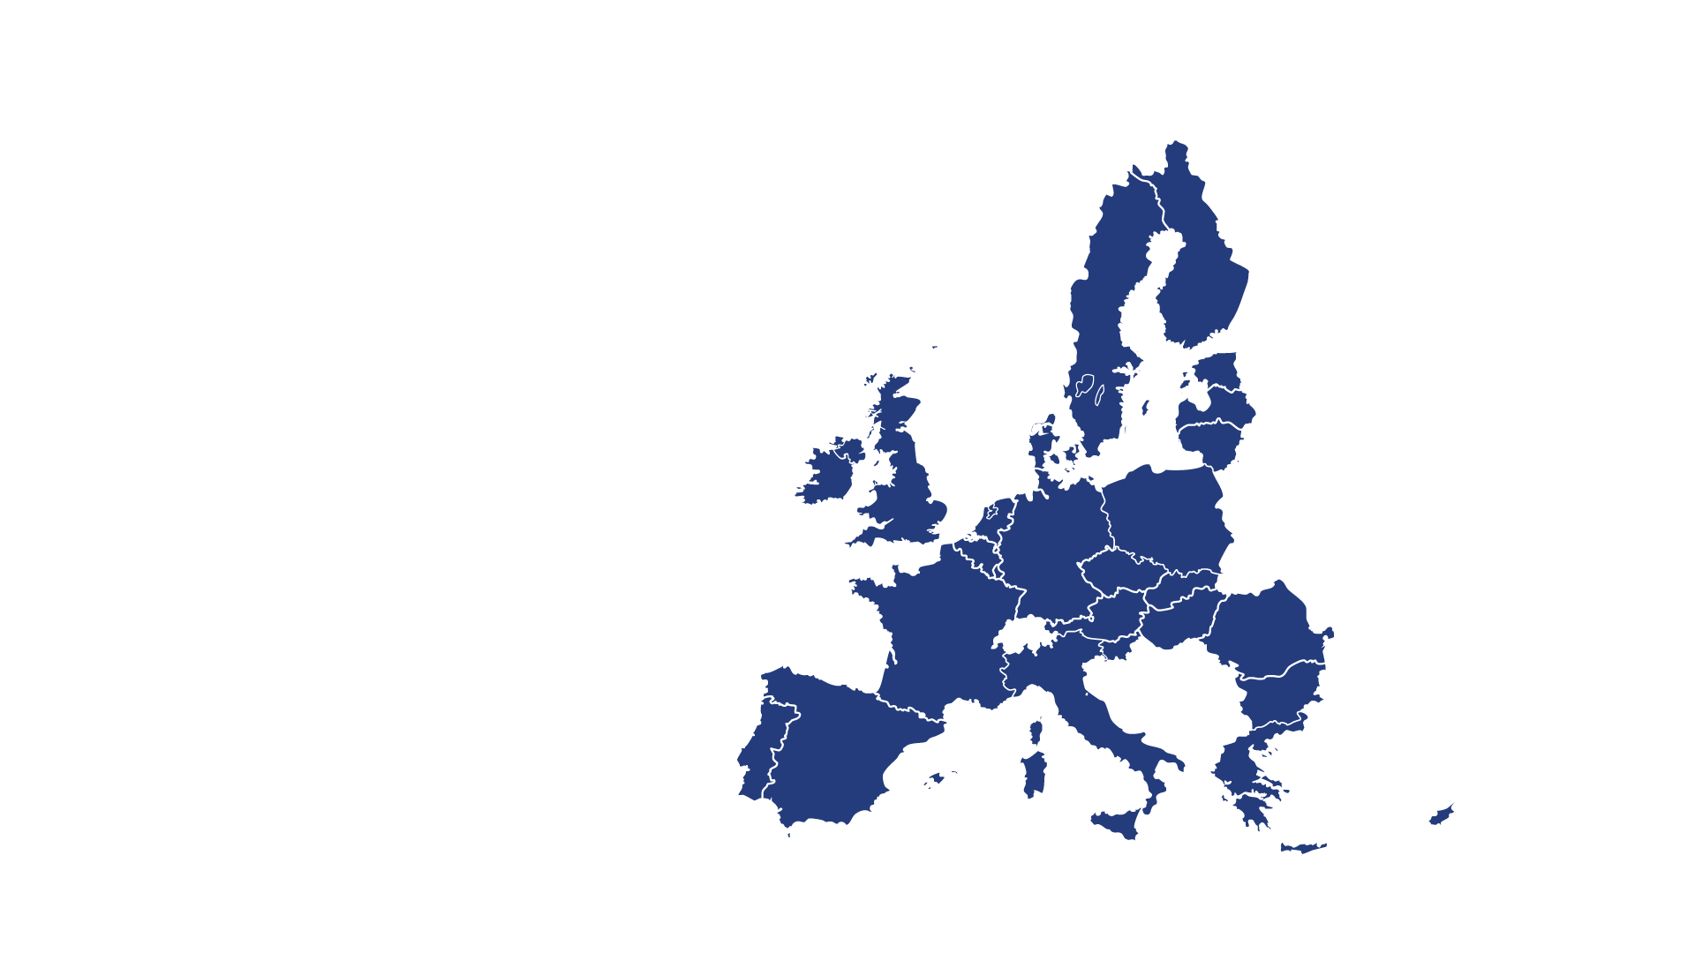
European integration in 2007: Bulgaria and Romania
European
integration
2007
In 2007, Bulgaria and Romania become Member States.

Slide 14
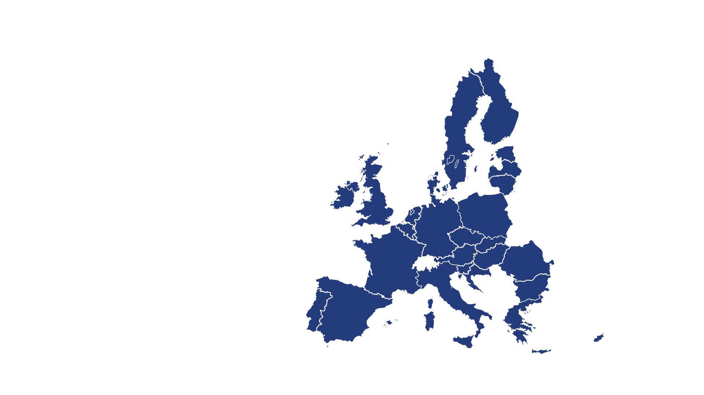
European integration in 2013: Croatia joins the EU
European
integration
2013
In 2013, Croatia became the latest country to join the Union.
Notes:
For an interactive map of EU enlargement over the years, visit:
https://www.europarl.europa.eu/external/html/euenlargement/default_en.htm

Slide 15
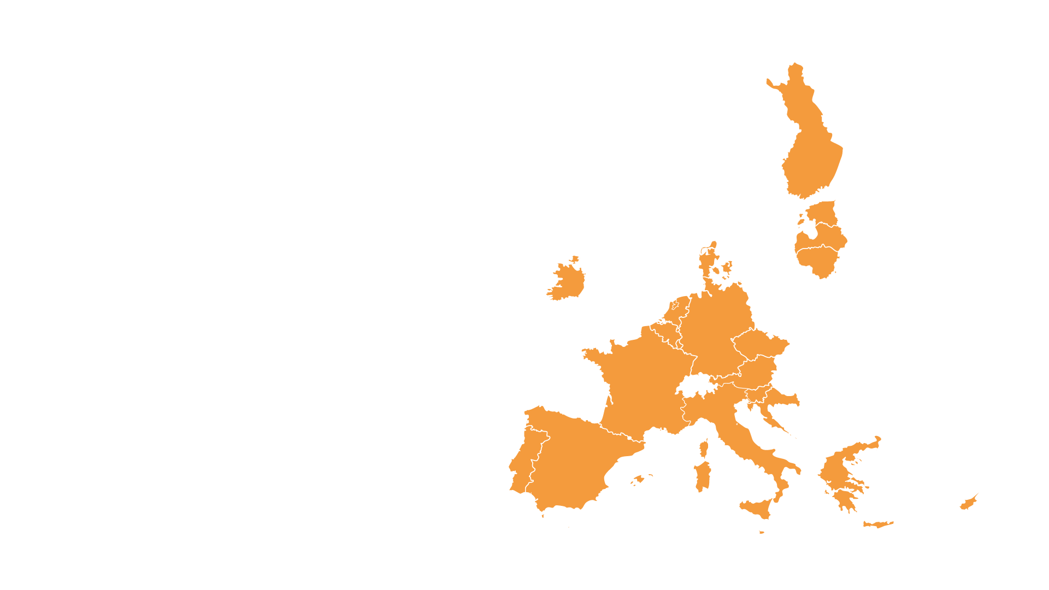
The euro and the euro area
The euro and the euro area
The euro is the official currency in the 20 EU countries that make up the euro area, also known as the Eurozone.
Notes:
While the aforementioned countries all form part of the European Union, not all of them are part of the euro area, also called the Eurozone.
The Eurozone refers to the region that consists of all the EU countries that have adopted the euro as their national currency.
The euro is a tangible sign of European integration and brings convenience for citizens and many advantages for businesses. Due to its importance as a global currency, the euro also brings added value to the Union's foreign policies.
Denmark is the only EU Member State that has agreed on an opt-out from the euro. The European Central Bank and the European Commission are in charge of maintaining its value and stability, and of establishing the criteria required for EU countries to enter the euro area.
The euro is the second most important currency in the world. The proportion of international payments made in euros and US dollars is roughly equal and the euro is the world’s second favourite currency for borrowing, lending and central bank reserves.
It is also used as an official or de facto currency as well as an 'anchor' currency by a number of countries outside the European Union.

Slide 16
EU enlargement
EU enlargement
Any European country can apply for membership if it respects the EU's democratic values and is committed to promoting them.
Notes:
Countries that want to become part of the EU have to meet strict EU membership conditions and enter into formal membership negotiations.
Formal membership negotiations involves the adoption of established EU law (known as the ‘acquis’), preparations to be ready to apply and enforce it, and implementation of judicial, administrative, economic and other reforms needed to meet the conditions for joining, known as accession criteria.
Membership criteria: known as the “Copenhagen criteria”, cover areas such as:
• the democratic institutional framework, the rule of law, human rights and respect for and protection of minorities;
• a functioning market economy and the capacity to cope with competition and market forces in the EU;
• the ability to take on and effectively implement the obligations of EU membership, including adhering to the aims of political, economic and monetary union.

Slide 17


Candidate countries
Candidate countries
• Albania
Bosnia and Herzegovina
• Moldova
• North Macedonia
• Montenegro
• Serbia
• Türkiye
• Ukraine
Notes:
A country can only join if it meets all the membership criteria.
There are 3 main steps, which must be approved by all EU countries:
Award of candidate status
Negotiations
Accession Agreement
The enlargement process benefits both the Union and the candidate states as it helps foster stability, democracy and economic growth in the neighborhood.

Slide 18
Potential candidate countries
Potential candidates
Kosovo*
Georgia
*This designation is without prejudice to positions on status

Slide 19
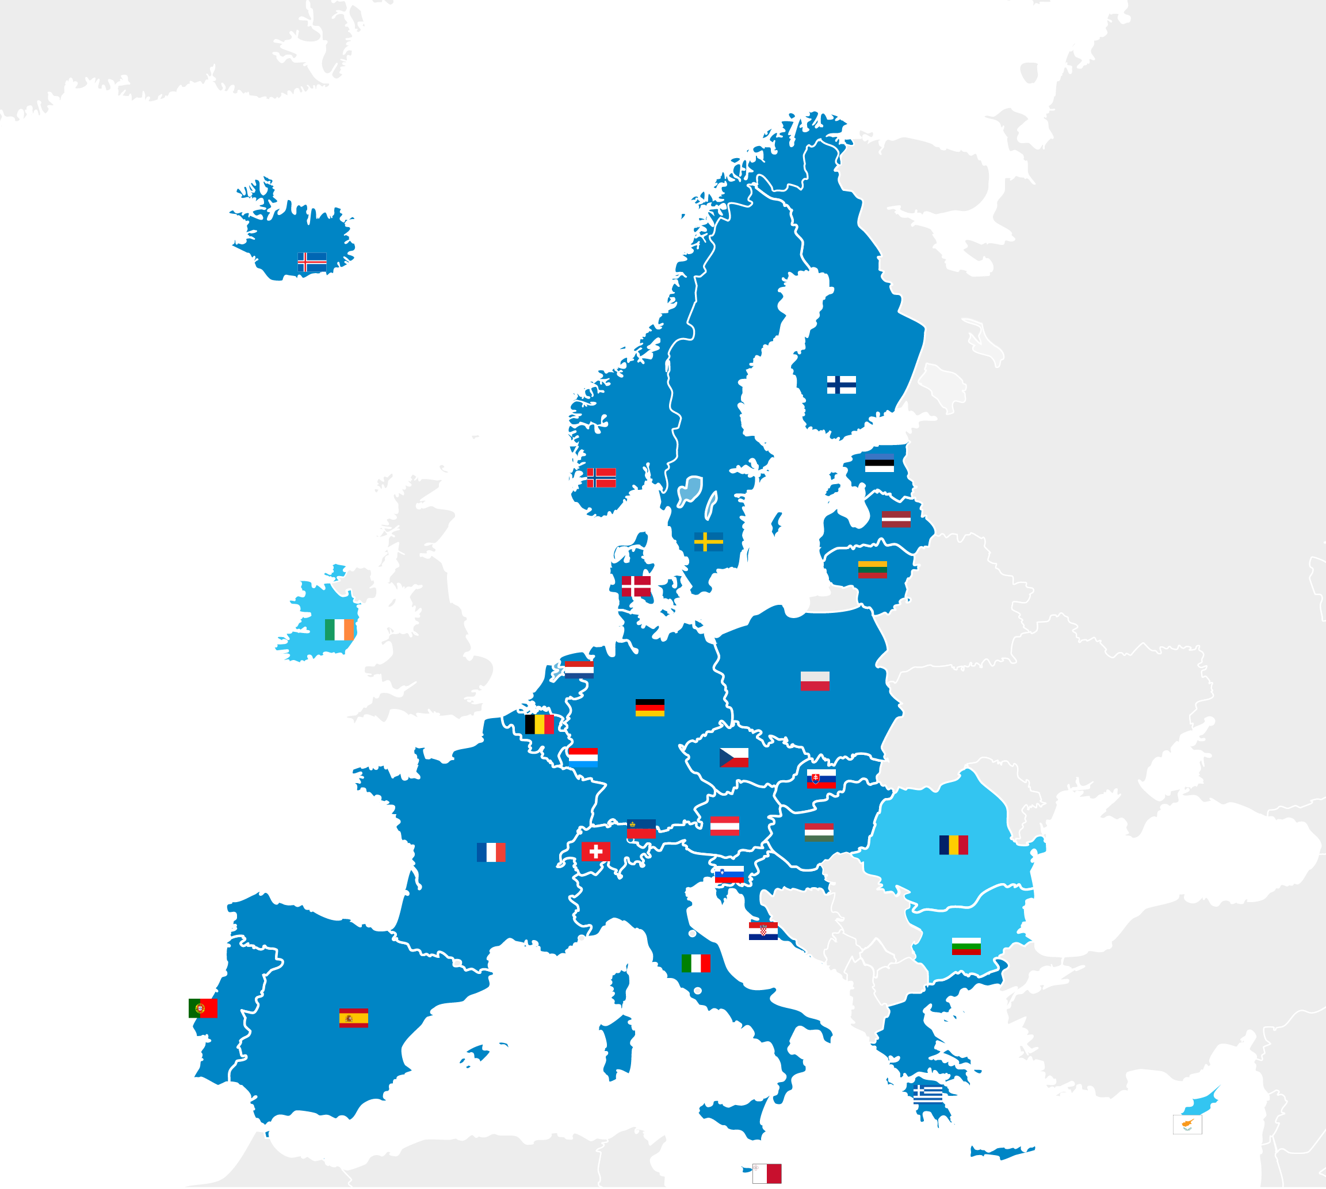
You can travel without a visa between the EU member States countries.
SCHENGEN AREA
You can travel freely between the countries of the Schengen area without showing your ID/passport.
THE EUROPEAN PROJECT
Schengen area countries
Non-Schengen area EU countries
Notes:
The Schengen area was established in 1995 for EU countries to remove controls at their borders.
EU citizens can move freely within this area. The Schengen area brings together 23 EU countries (Austria, Belgium, Croatia, Czechia, Denmark, Estonia, Finland, France, Germany, Greece, Hungary, Italy, Latvia, Lithuania, Luxembourg, Malta, Netherlands, Poland, Portugal, Slovakia, Slovenia, Spain, Sweden) and 4 non-EU countries (Iceland, Liechtenstein, Norway and Switzerland).

Slide 20

HOW DOES THE EU WORK ?
PLAY TIME!!

Slide 21



THE EUROPEAN COMMISSION
represents the EU common interests
is made up of one President and a Commissioner from each EU country responsible for a specific topic
proposes new laws and programmes
is elected by the European Parliament for
five years
manages the EU policies and budget
is the guardian of the EU Treaties
is located in Brussels and Luxembourg
© EUROPEAN UNION
HOW DOES THE EU WORK?
© EUROPEAN UNION
© EUROPEAN UNION
Notes:
Go to ec.europa.eu to access the official website of the European Commission.

Slide 22


THE EUROPEAN COUNCIL
brings together the heads of state or government of each EU country
sets the EU’s main priorities and policy directions
meets at least four times a year in Brussels (Belgium) or Luxembourg (Luxembourg) for European Summits
does not adopt EU laws
HOW DOES THE EU WORK?
© EUROPEAN UNION
Notes:
Go to consilium.europa.eu to access the official website of the Council of the EU.

Slide 23



THE EUROPEAN PARLIAMENT
is the voice of European citizens
has Members from all EU countries directly elected by citizens every five years
discusses new laws proposed by the European Commission
modifies (if necessary) and decides these laws together with the Council
elects the President of the European Commission
approves the EU budget
holds at least six sessions per year in Brussels (Belgium) and 12 in Strasbourg (France)
© EUROPEAN UNION
HOW DOES THE EU WORK?
© Creative Commons Attribution-Share Alike 4.0 International
Notes:
Go to europarl.europa.eu to access the official website of the European Parliament.

Slide 24
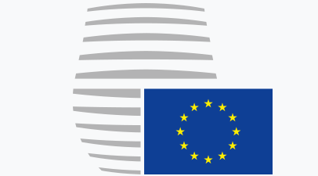


THE COUNCIL OF THE EU
represents the governments of the EU countries
brings together ministers of EU countries who meet to discuss EU matters (agriculture, foreign affairs, justice, etc.)
takes decisions and passes laws together with the European Parliament
has a rotating Presidency – every six months another EU country takes the lead
meets in Brussels or Luxembourg
© EUROPEAN UNION
HOW DOES THE EU WORK?
© EUROPEAN UNION
Notes:
Go to consilium.europa.eu to access the official website of the Council of the EU.

Slide 25

European Commission
Proposes a law
Adopt, amend or reject the proposed law
European Parliament
Council of the European Union
If agreed
HOW DOES THE EU WORK?
NEW EU LAW

Slide 26
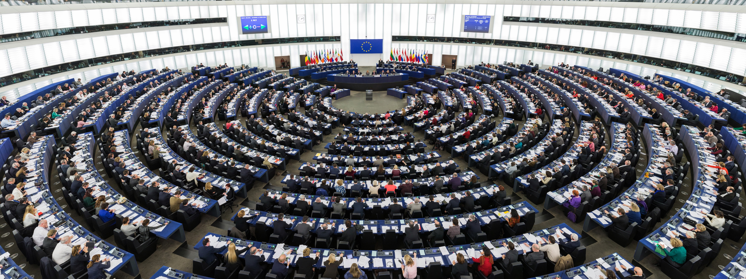
When did it happen quiz
The European elections
1957 Rome Treaty - The EU Parliament has a consulative role
1974 The Paris Summit - decision to elect the Parliament by direct universal suffrage
1979 First European Elections
Notes:
The EU has dealt with several challenges throughout the years. Let us now look at the most significant challenges that the EU has navigated throughout the decades.
For a more detailed overview of EU history, you can access a timeline of the EU online: History of the EU, EU pioneers | European Union (europa.eu)
1952
The six countries are Belgium, Germany, France, Italy, Luxembourg, and the Netherlands. The European Coal and Steel Community comes into being in 1952.
Later, in 1958, the 6 countries will go on to create the European Community with the signing of the Treaty of Rome (recall slide 9 of this presentation).
The 1970s
Denmark, Ireland and the United Kingdom join the European Communities on 1 January 1973, raising the number of member countries to 9. The Arab-Israeli war of October 1973 triggers an energy crisis and economic problems in Europe.
Democracy spreads in Europe with the overthrow of the dictatorships in Greece, Portugal and Spain. Regional policy starts to transfer huge sums of money to create jobs and infrastructure in poorer areas. The first direct elections by citizens of members of the European Parliament take place in 1979.
The 1990s
With the collapse of communism across central and eastern Europe, Europeans become closer neighbours.
People are concerned about how to protect the environment and also how Europeans can cooperate on security and defence matters.
2010-2019
The global economic crisis strikes hard in Europe. In 2012, the European Union is awarded the Nobel Peace Prize. Unrest and wars in various countries lead many people to flee their homes and seek refuge in Europe. The EU is faced with the challenge of how to take care of them, while safeguarding their welfare and respecting their human rights. Climate change is at the top of the agenda and leaders agree to reduce harmful emissions. Croatia becomes the 28th member of the EU in 2013. But in a referendum in 2016, the United Kingdom votes to leave the EU.
2020-today
January 2020 – Common EU response to COVID-19
The COVID-19 pandemic triggers a major public health emergency and economic slowdown. The EU and its member countries work together to support healthcare systems, contain the spread of the virus, and secure vaccines for people in the EU and beyond. EU leaders agree the largest stimulus package ever financed from the EU budget with the focus on a green and digital recovery as the EU works towards climate neutrality by 2050.
31 January 2020 – United Kingdom leaves the EU
The UK leaves the EU after 47 years of membership, opening a new chapter in its relationship with the EU.
Relations with the United Kingdom
April 2021 – Launch of the Conference on the Future of Europe
The EU launches the year-long Conference on the Future of Europe in 2021. The unprecedented exercise in participatory democracy offers EU citizens a unique opportunity to have their say and help shape the EU’s future.
February 2022 – Russia invades Ukraine
The EU and its international partners firmly condemn Russia’s unjustified and unprovoked war of aggression. The EU adopts a series of hard-hitting sanctions against Russia and provides financial, humanitarian, military and other assistance to Ukraine.

Slide 27
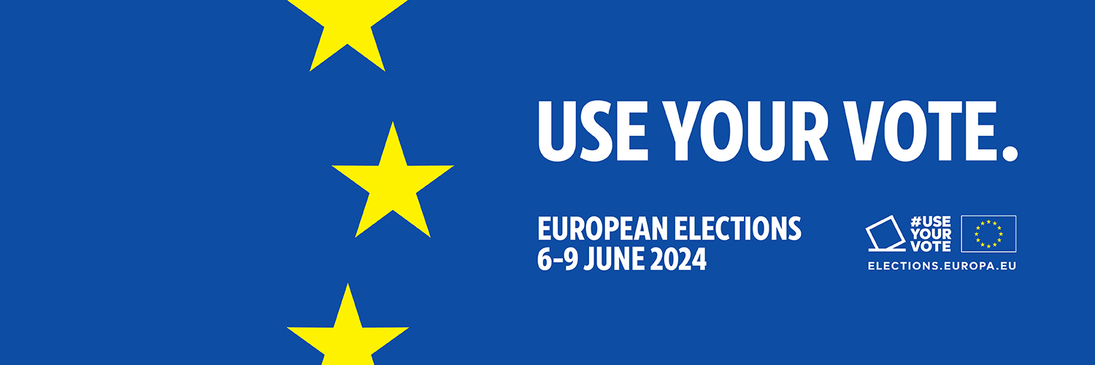
When did it happen quiz
Your turn
Who is the Commissionner your country nominated for 2019-2024 ?
How many deputies will be elected from your country in June 2024 ?
How will the European elections happen in your country in June? (date § constituency)
Notes:
The EU has dealt with several challenges throughout the years. Let us now look at the most significant challenges that the EU has navigated throughout the decades.
For a more detailed overview of EU history, you can access a timeline of the EU online: History of the EU, EU pioneers | European Union (europa.eu)
1952
The six countries are Belgium, Germany, France, Italy, Luxembourg, and the Netherlands. The European Coal and Steel Community comes into being in 1952.
Later, in 1958, the 6 countries will go on to create the European Community with the signing of the Treaty of Rome (recall slide 9 of this presentation).
The 1970s
Denmark, Ireland and the United Kingdom join the European Communities on 1 January 1973, raising the number of member countries to 9. The Arab-Israeli war of October 1973 triggers an energy crisis and economic problems in Europe.
Democracy spreads in Europe with the overthrow of the dictatorships in Greece, Portugal and Spain. Regional policy starts to transfer huge sums of money to create jobs and infrastructure in poorer areas. The first direct elections by citizens of members of the European Parliament take place in 1979.
The 1990s
With the collapse of communism across central and eastern Europe, Europeans become closer neighbours.
People are concerned about how to protect the environment and also how Europeans can cooperate on security and defence matters.
2010-2019
The global economic crisis strikes hard in Europe. In 2012, the European Union is awarded the Nobel Peace Prize. Unrest and wars in various countries lead many people to flee their homes and seek refuge in Europe. The EU is faced with the challenge of how to take care of them, while safeguarding their welfare and respecting their human rights. Climate change is at the top of the agenda and leaders agree to reduce harmful emissions. Croatia becomes the 28th member of the EU in 2013. But in a referendum in 2016, the United Kingdom votes to leave the EU.
2020-today
January 2020 – Common EU response to COVID-19
The COVID-19 pandemic triggers a major public health emergency and economic slowdown. The EU and its member countries work together to support healthcare systems, contain the spread of the virus, and secure vaccines for people in the EU and beyond. EU leaders agree the largest stimulus package ever financed from the EU budget with the focus on a green and digital recovery as the EU works towards climate neutrality by 2050.
31 January 2020 – United Kingdom leaves the EU
The UK leaves the EU after 47 years of membership, opening a new chapter in its relationship with the EU.
Relations with the United Kingdom
April 2021 – Launch of the Conference on the Future of Europe
The EU launches the year-long Conference on the Future of Europe in 2021. The unprecedented exercise in participatory democracy offers EU citizens a unique opportunity to have their say and help shape the EU’s future.
February 2022 – Russia invades Ukraine
The EU and its international partners firmly condemn Russia’s unjustified and unprovoked war of aggression. The EU adopts a series of hard-hitting sanctions against Russia and provides financial, humanitarian, military and other assistance to Ukraine.

Slide 28

Copyright information slide
© European Union 2023
Unless otherwise noted the reuse of this presentation is authorised under the CC BY 4.0 license. For any use or reproduction of elements that are not owned by the EU, permission may need to be sought directly from the respective right holders.
Slide 7 photo, source: © Adobe Stock, Jacob Lund

