Slide 1


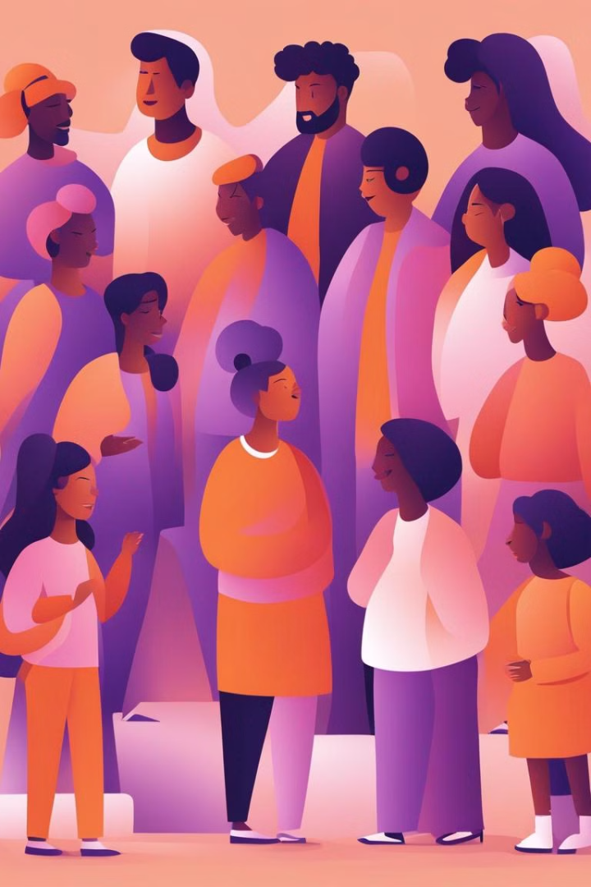

Funded by the European Union. Views and opinions expressed are however those of the author(s) only and do not necessarily reflect those of the European Union or European Education and Culture Executive Agency (EACEA). Neither the European Union nor the granting authority can be held responsible for them.
Introduction to Debating
An effective debate involves the skilled exchange of ideas and viewpoints in a structured and respectful manner. It requires the ability to articulate thoughts clearly and persuasively.

Slide 2
Purpose of Debates
1
Information Exchange
2
Skill Development
3
Promoting Empathy
Participating in debates hones critical thinking, public speaking, and research skills.
Encourages individuals to understand differing viewpoints and cultivate empathy.
Debates offer a platform to share diverse perspectives and valuable insights on complex issues.

Slide 3

Types of Debates
1
Formal Debates
Structured and regulated contests following specific rules and time limits.
2
Informal Debates
More flexible and freestyle discussions, often in casual settings.
3
Team Debates
Teams compete against each other with defined roles and responsibilities.

Slide 4
Structure of a Debate
Opening Statements
Rebuttals
Cross-Examination
Presenting the initial stance and setting the stage for the debate.
Responding to opponents' arguments and presenting counterpoints.
Questioning opponents to uncover weaknesses in their arguments.

Slide 5

Debate Preparation
Research
Practice
Thoroughly investigate the topic and gather evidence to support your arguments.
Prepare and rehearse speeches and anticipate potential counterarguments.
Understanding Your Audience
Adapt your presentation style to resonate with different audience demographics.

Slide 6




Key Skills for Debating
Effective Communication
Critical Thinking
Adaptability
Analyze and evaluate information to form logical and well-supported arguments.
Ability to spontaneously adjust strategies based on opponent responses and audience feedback.
Express ideas clearly and persuasively through speech and body language.

Slide 7

Common Debate Tactics
1
Appeal to Emotion
2
Logical Fallacies
Using emotional language to sway opinions in the absence of strong evidence.
Avoiding flawed reasoning and identifying deceptive argument tactics.
3
Strategic Language
Adopting persuasive language and rhetoric tailored to the specific audience.

Slide 8
Conclusion and Next Steps
Summarize key points
Offer opportunities for further engagement
Encourage respectful discourse
Express gratitude to participants

